Slide 1
Unit 3 Boolean algebra and Logic gates

Slide 2
Logic gates are the basic building blocks of any digital system, which execute numerous logical operations that are required by any digital circuit.
The output of a logic gate depends on the combination of inputs and the logical operation that the logic gate performs.
Truth table consists of all the possible combinations of the inputs and the corresponding of output of a logic gate.
The relationship between the inputs and the outputs of a gate can be expressed as Boolean expression.

Slide 3
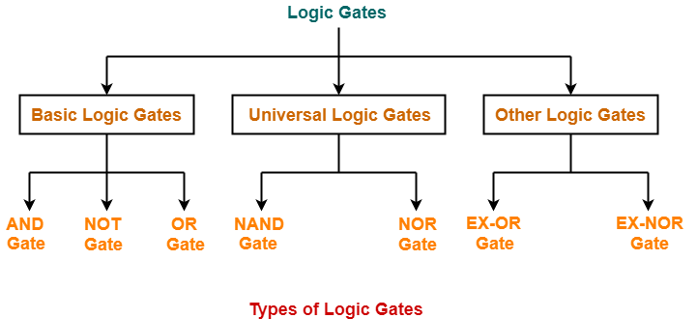
Classification of gates

Slide 4
Logic operators
1. AND operator
(A. B → logical multiplication)
2. OR operator
(A+B → logical addition)
3. NOT operator
( Ā→ logical inversion)

Slide 5
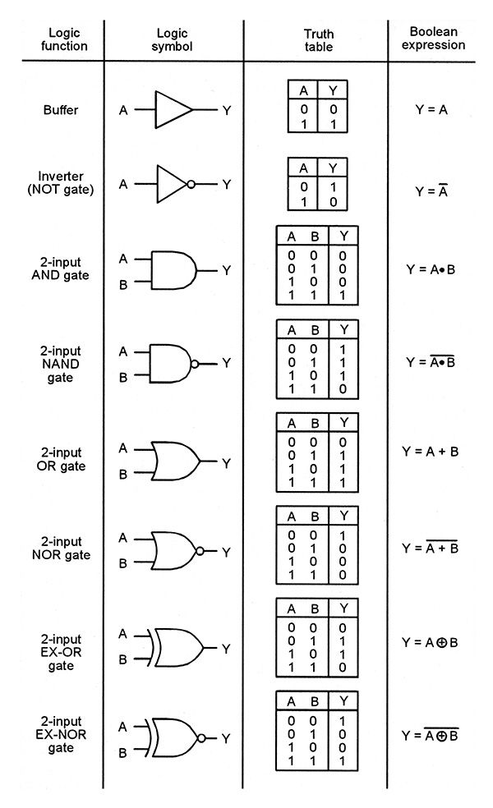

Slide 6
Boolean algebra
used to analyze and simplify the digital circuits.
The rules of Boolean algebra are:
Boolean algebra allows only two possible values (0 or 1) for any variable.
Symbols used in Boolean algebra (usually letters) do not represent numerical values.
Arithmetic operations like subtraction, division are not performed. Also, there are no fractions, negative numbers, square, square root etc.

Slide 7
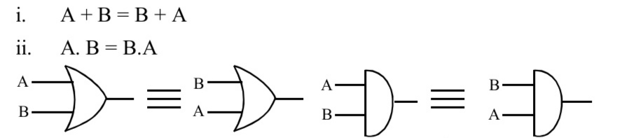
Boolean laws :
1. Commutative law: This law allows change in the position of the input variables in OR and AND expression.

Slide 8
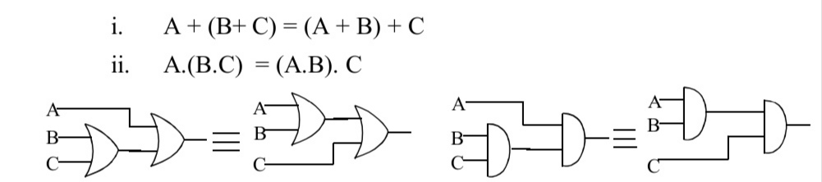
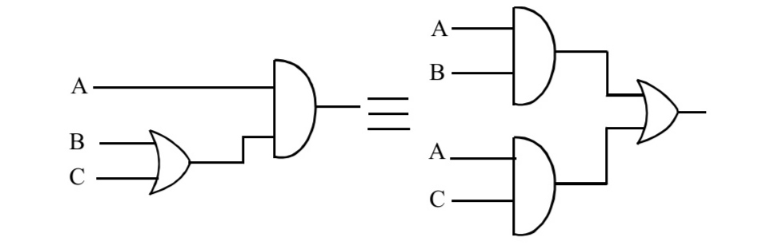
Boolean Laws:
2. Associative law: The law states that it make no difference in what order the variables are grouped when ORing or ANDing more than two variables.
3. Distributive law: This law permits factoring or multiplying out an expression.
i. A(B + C) = AB + AC ii. AB + AC = A (B + C)

Slide 9
Boolean Laws
4. OR law:
i) A + 0 = A ii) A + 1 = 1 iii) A + A = A iv) A + Ā = 1
5. AND law:
i) A. 0 = 0 ii) A. 1 = A
iii) A.A=A
iv) A. Ā =0
6. Inversion law:
A =A

Slide 10
Boolean Laws contd..
A+AB=A
LHS =A+AB
=A(1+B)
=A.1=A [ 1+B=1]
=RHS
(A+ ĀB)=A+B
(A+B)(A+C)=A+BC

Slide 11
Duality theorem
It states that starting with a Boolean relation, we can derive another Boolean relation by: i. changing each OR sign to an AND sign and vice versa. ii. complementing any 0 or 1 appearing in the expression. For example,:
A + 0 = A, the dual relation is A.1 = A
A (B + C) = AB + AC Its dual relation is, A + BC = (A + B) (A + C)

Slide 12
Huntington Postulates
Boolean algebra systems employ the postulates formulated by E. V. Huntington in 1904.
Postulates
P1: 1 (a) Closure with respect to the operator + .
(b) Closure with respect to the operator • .
P2: 2(a) An identity element with respect to +, designated by 0:
x + 0 = 0 + x = x,
(b) An identity element with respect to •, designated by 1:
x. 1 = 1. x = x
P3: 3(a) Commutative with respect to + : x + y = y + x
(b) Commutative with respect to • : x • y = y • x

Slide 13
Huntington Postulates
Postulates
P4: 4 (a): • is distributive over + :
x • (y + z) = (x • y) + (x • z).
(b): + is distributive over • :
x + (y • z) = (x + y) • (x + z), for all x, y, z ∈ B.
P5: For every value x there exists a value x’ (complement or inverse)such that x • x' = 0 and x + x' = 1.
P6: There exists at least two elements x, y ∈ B such that x ≠ y.

Slide 14
Basic theorems
Theorem1: Idempotence (a) x + x = x (b) x . x = x
Theorem2: Existence: 0 and 1 (a) x + 1 = 1 (b) x.0 = 0
Theorem 1 and 2 are one variable theorems
Theorem3: Involution (x')' = x
Theorem4: Associative (a) x + (y + z) = (x + y) + z (b) x(yz) = (xy)z
Theorem5: De Morgan (a) (x + y)' = x'y' (b) (xy)' = x' + y’
Theorem6: Absorption (a) x + xy = x (b) x(x + y) = x
Theorem 3,4 and 5 are 2 or 3 variable theorems

Slide 15
Proofs:
THEOREM 1(a): x + x = x
x + x = (x + x) . 1 By postulate:2(b)
= (x + x)(x + x’) 5(a)
= x + x.x’ 4(b)
=x + 0 5(b)
=x 2(a)
THEOREM 1(b): x·x = x
x.x = x.x + 0 By postulate 2(a)
=x.x + x.x’ 5(b)
=x(x + x’) 4(a)
= x.1 5(a)
=x 2(b)

Slide 16
Proofs:
THEOREM 2(a): x + 1 = 1
x + 1 = 1· (x + 1) By postulate:2(b)
= (x + x')(x + 1) 5(a)
=x + x'·1 4(b)
= x + x’ 2(b)
=1 5(a)
THEOREM 2(b): x.0 = 0 by duality.
THEOREM 3: (x ')' = x.
From postulate 5, we have x + x' = 1 and x . x' = 0, which defines the complement of x. The complement of x' is x and is also (x')’.
Thus, we have that (x')' = x.

Slide 17
Proofs:
THEOREM 6(a): x + xy = x
x + xy = x.1 + xy By postulate:2(b)
= x (1+y) 4(a)
=x ·1 2(a)
= x 2(b)
THEOREM 6(b): x (x + y )= x by duality.

Slide 18
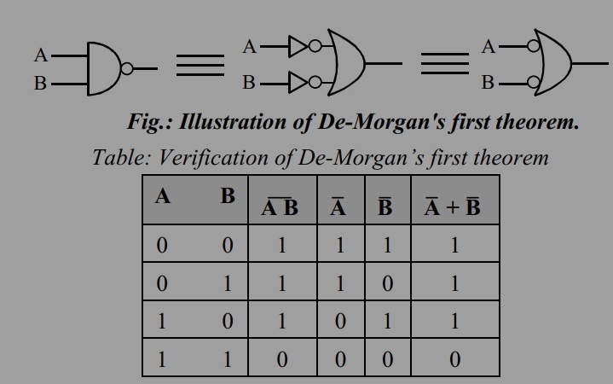

Theorem 5: De-Morgan’s theorem:
Theorem 1:
This theorem states that the complement of a product is equal to addition of the complements.
It shows that NAND gate is equivalent to bubbled OR gate.
$\overline{(A\text{•}B)}$=Ā+$\overline{B}$

Slide 19
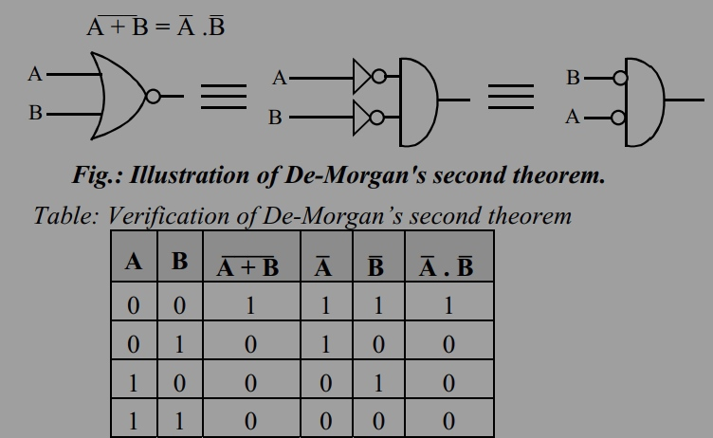
De-Morgan’s theorem:
Theorem 2:
This theorem states that the complement of a sum is equal to the product of complements.
It shows that NOR gate is equivalent to bubbled AND gate.

Slide 20
Universal Gates- NAND, NOR
NAND gates and NOR gates are called universal gates because any type of gates or logic functions can be implemented by using these gates.
small in size and easy for fabrication.

Slide 21
Universality of NAND and NOR gate
Implementation of all other gates using
i) NAND gates
ii) NOR gates

Slide 22
END OF UNIT 3

